Slide 1
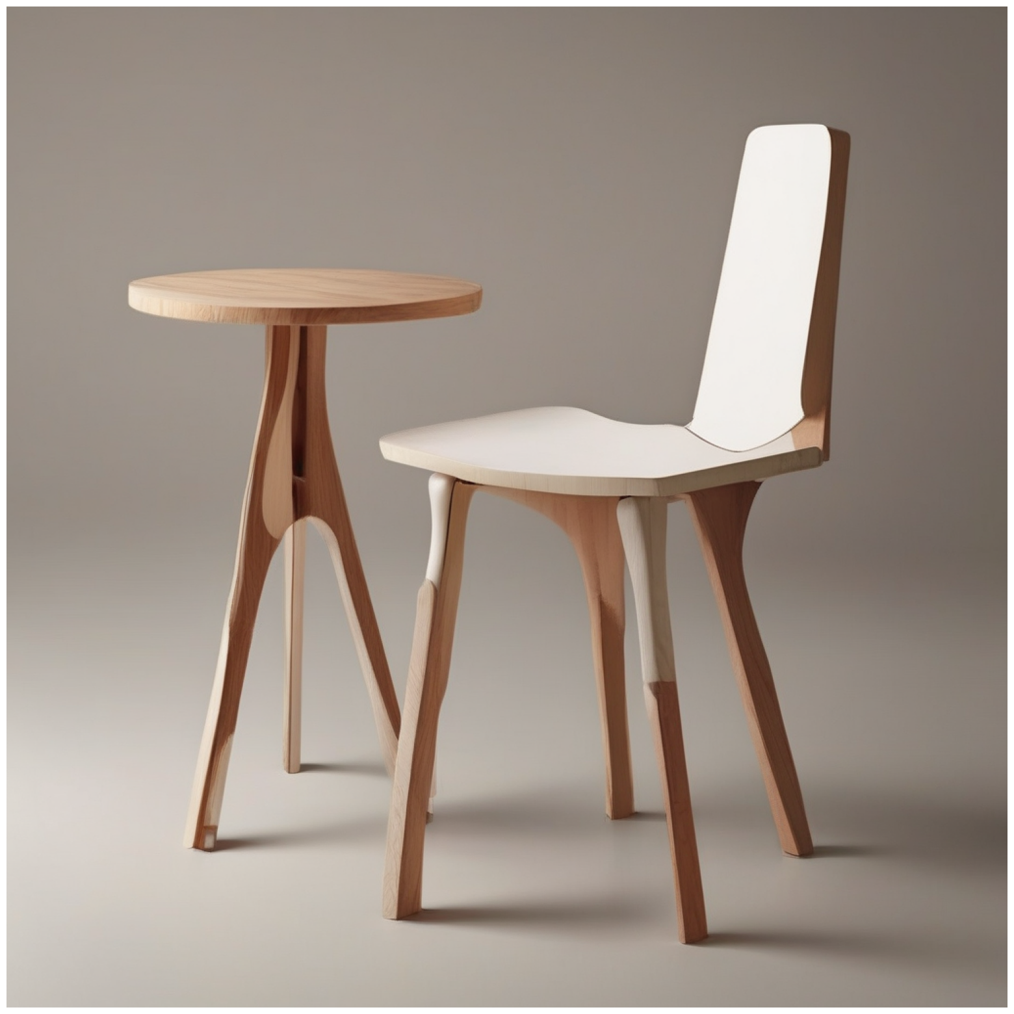
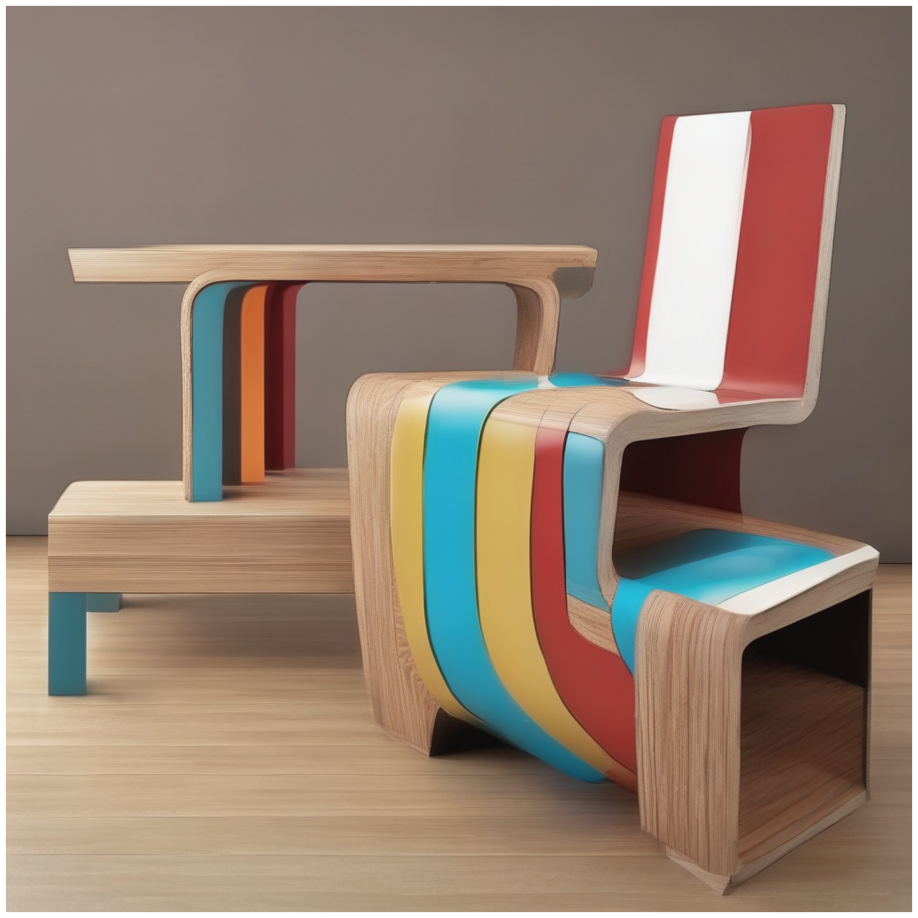
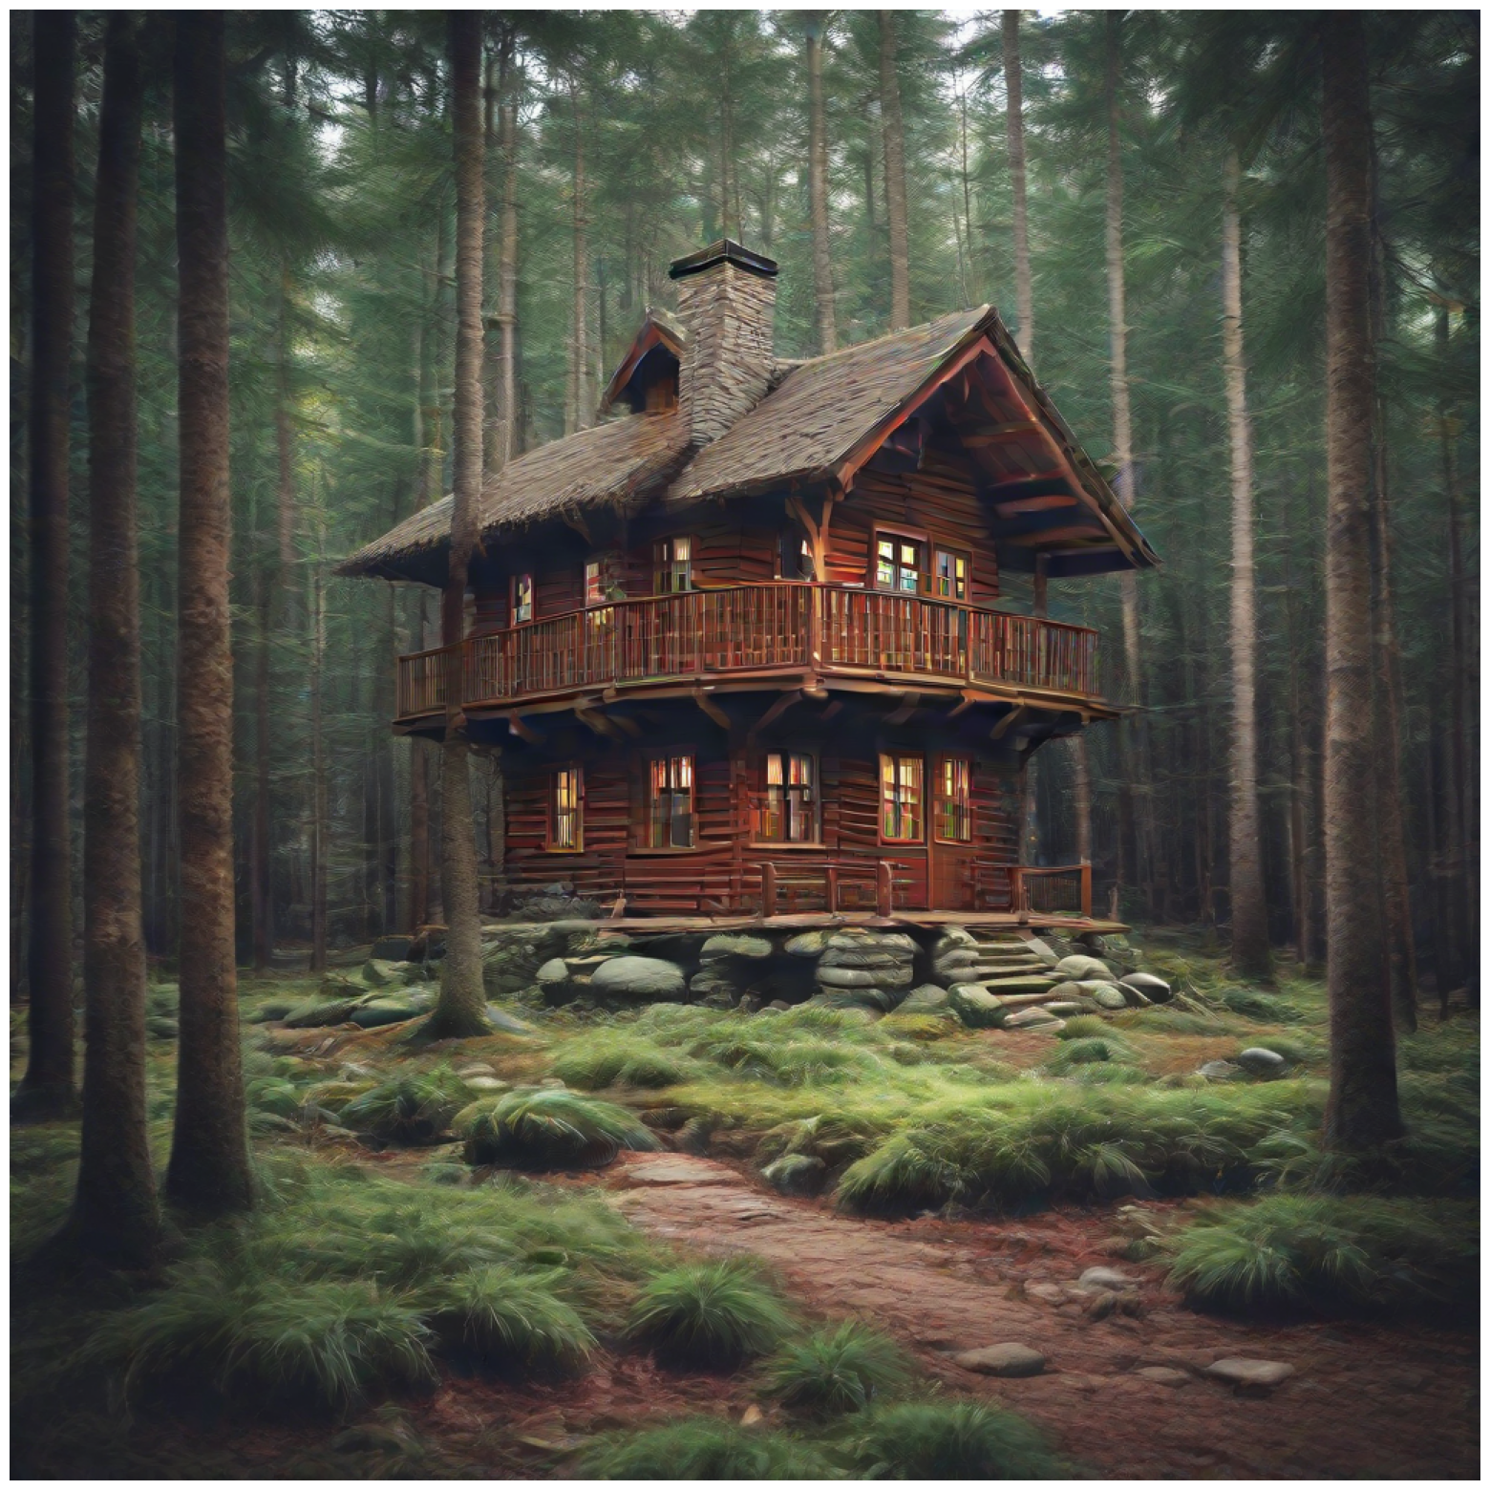
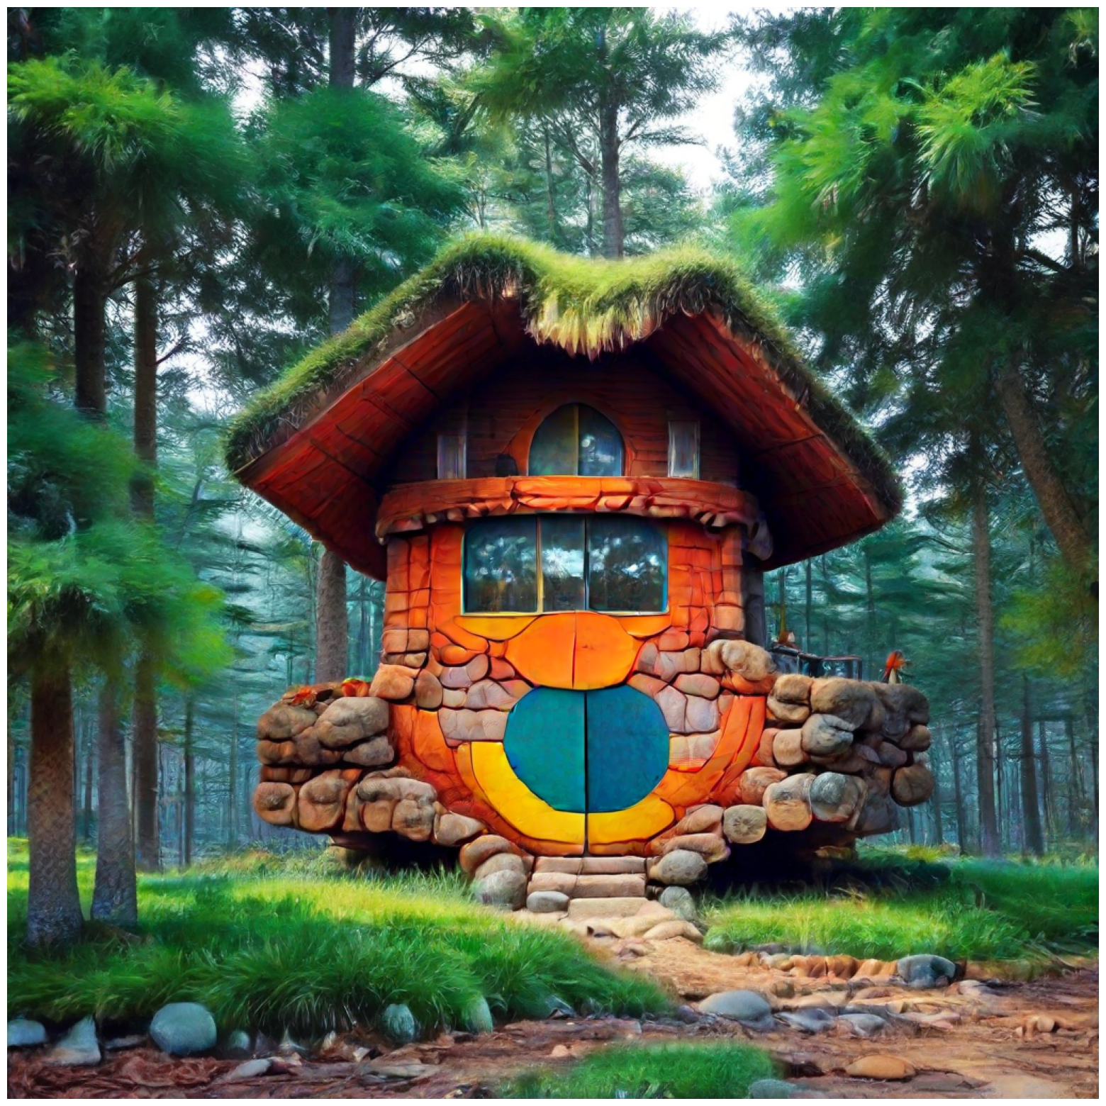
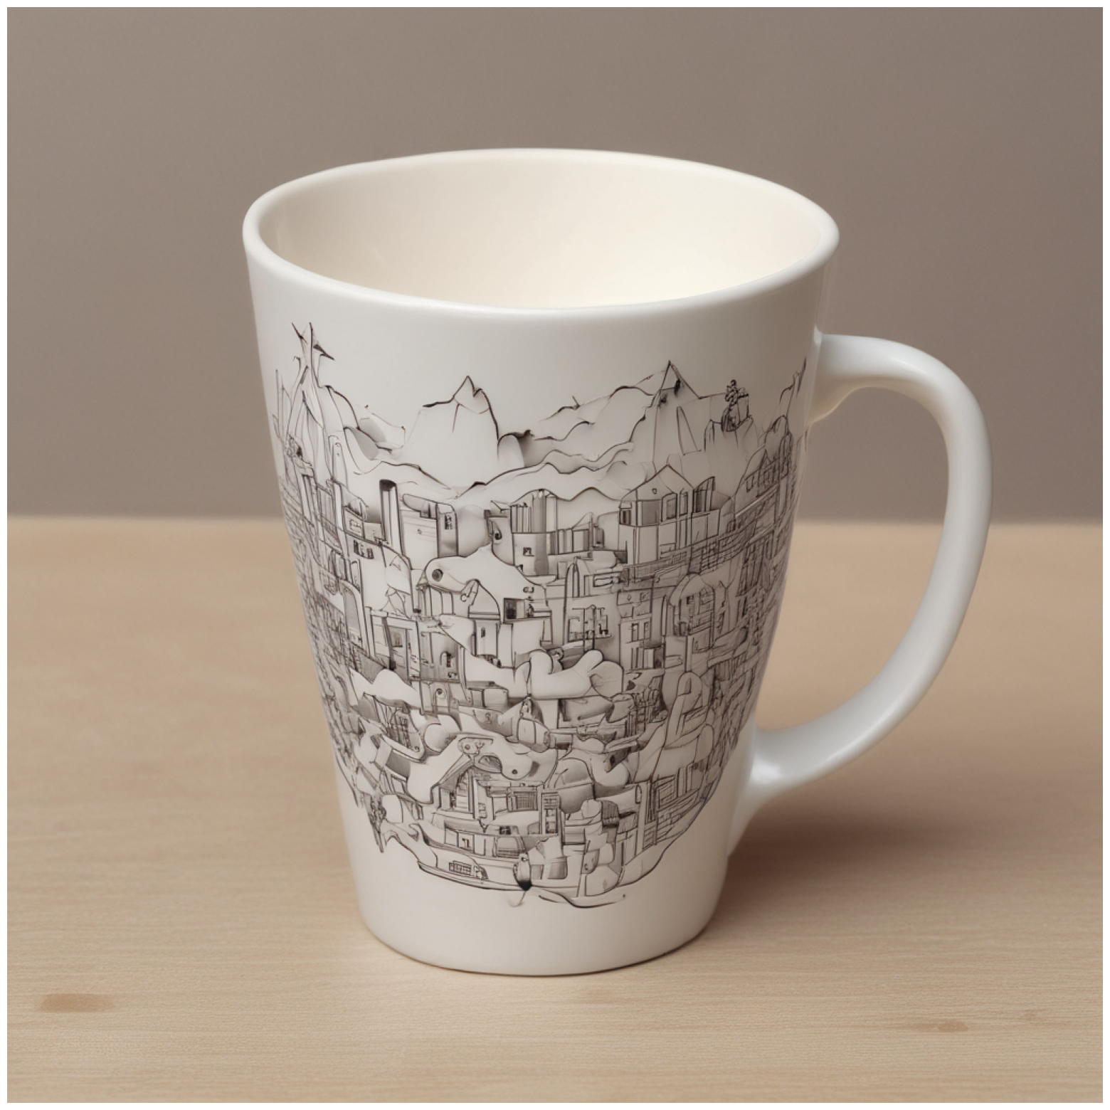
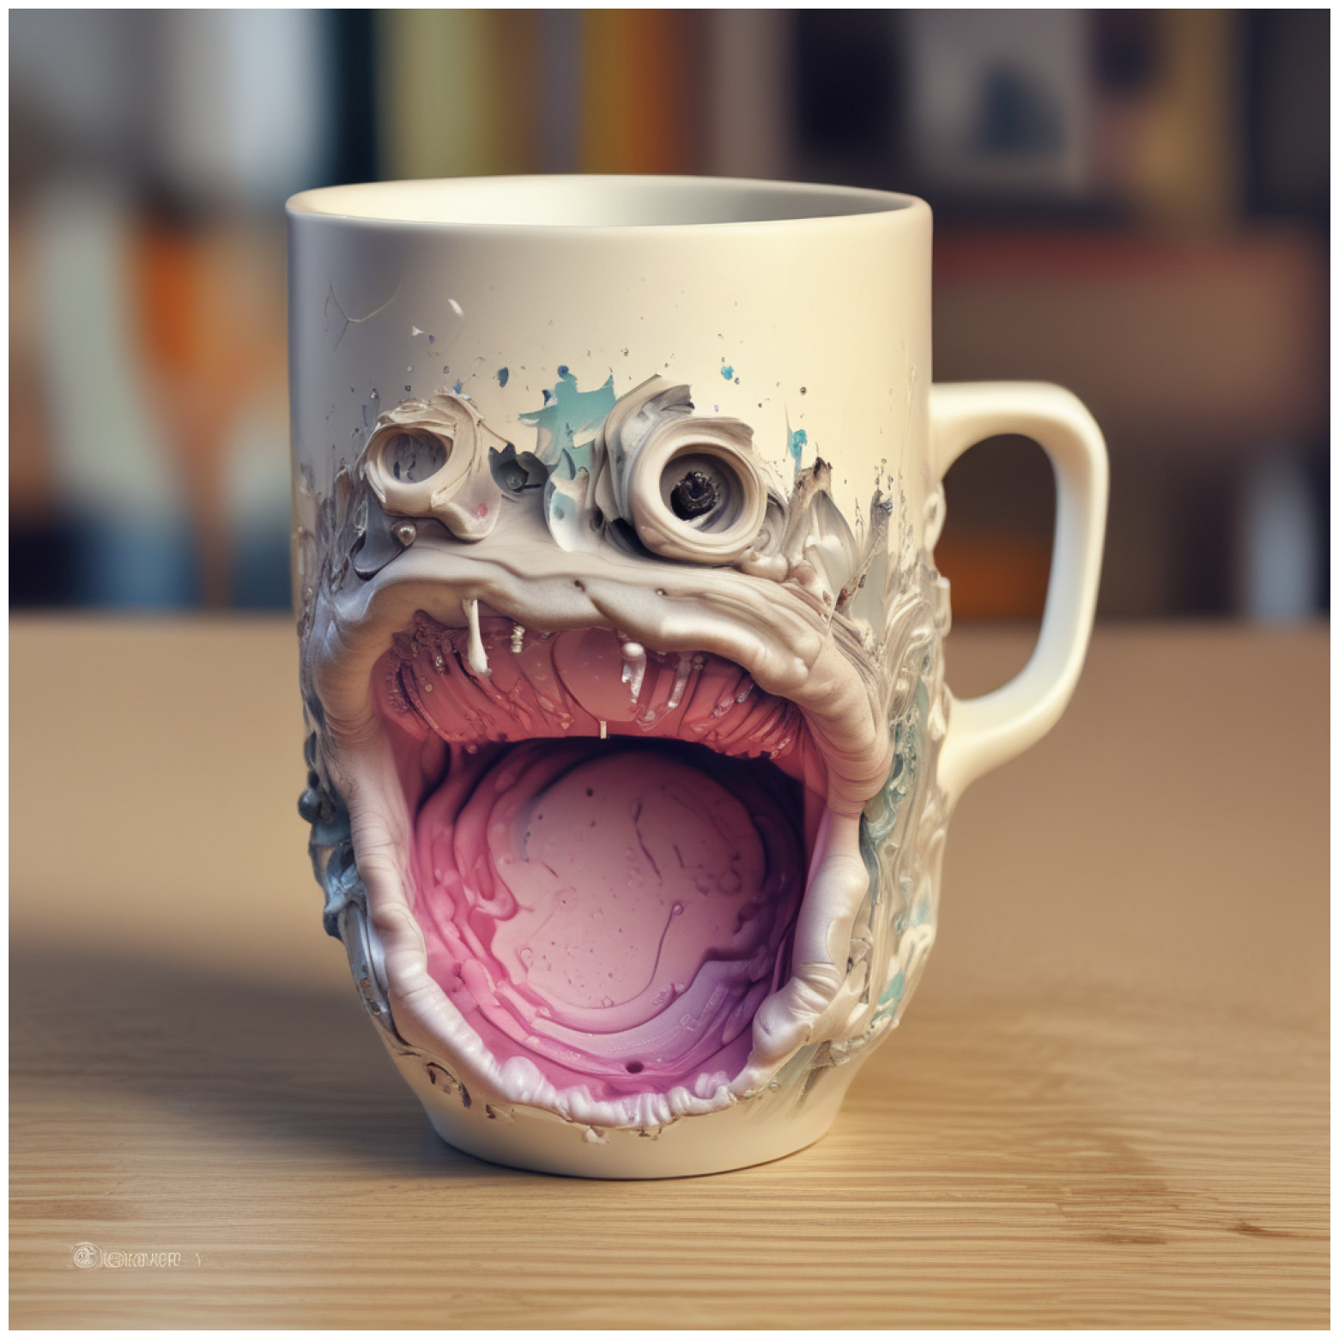
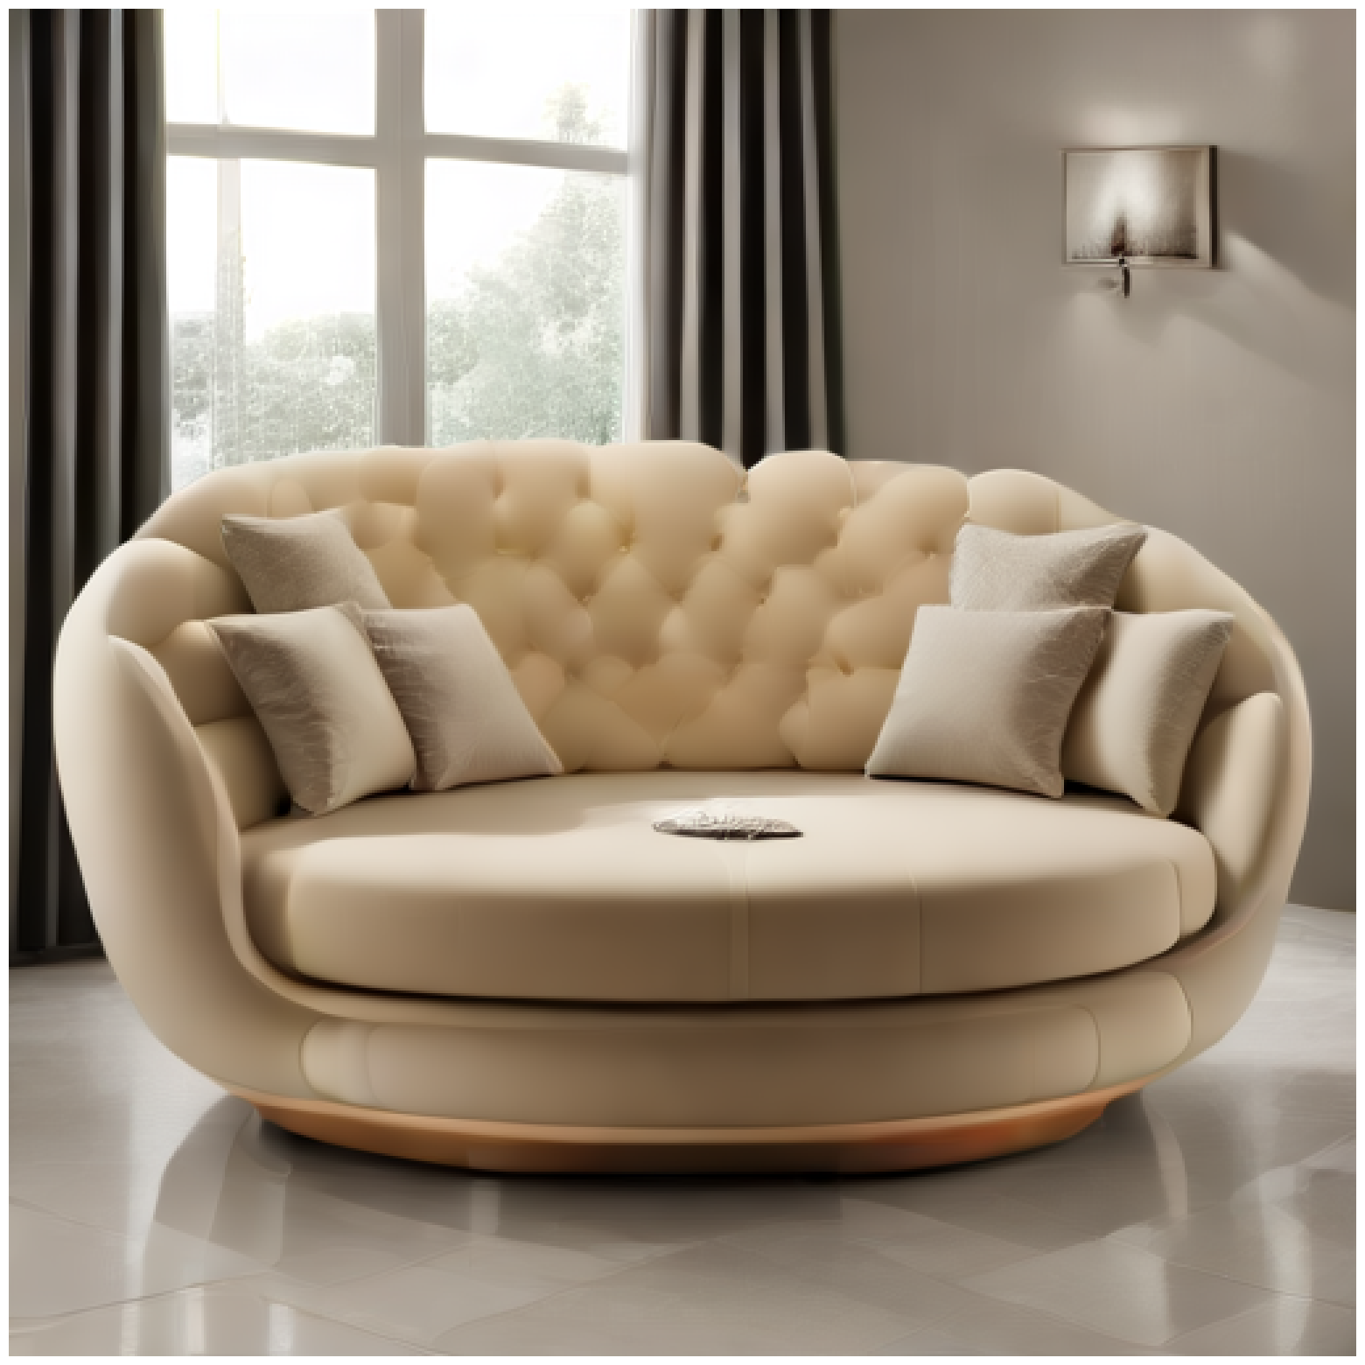
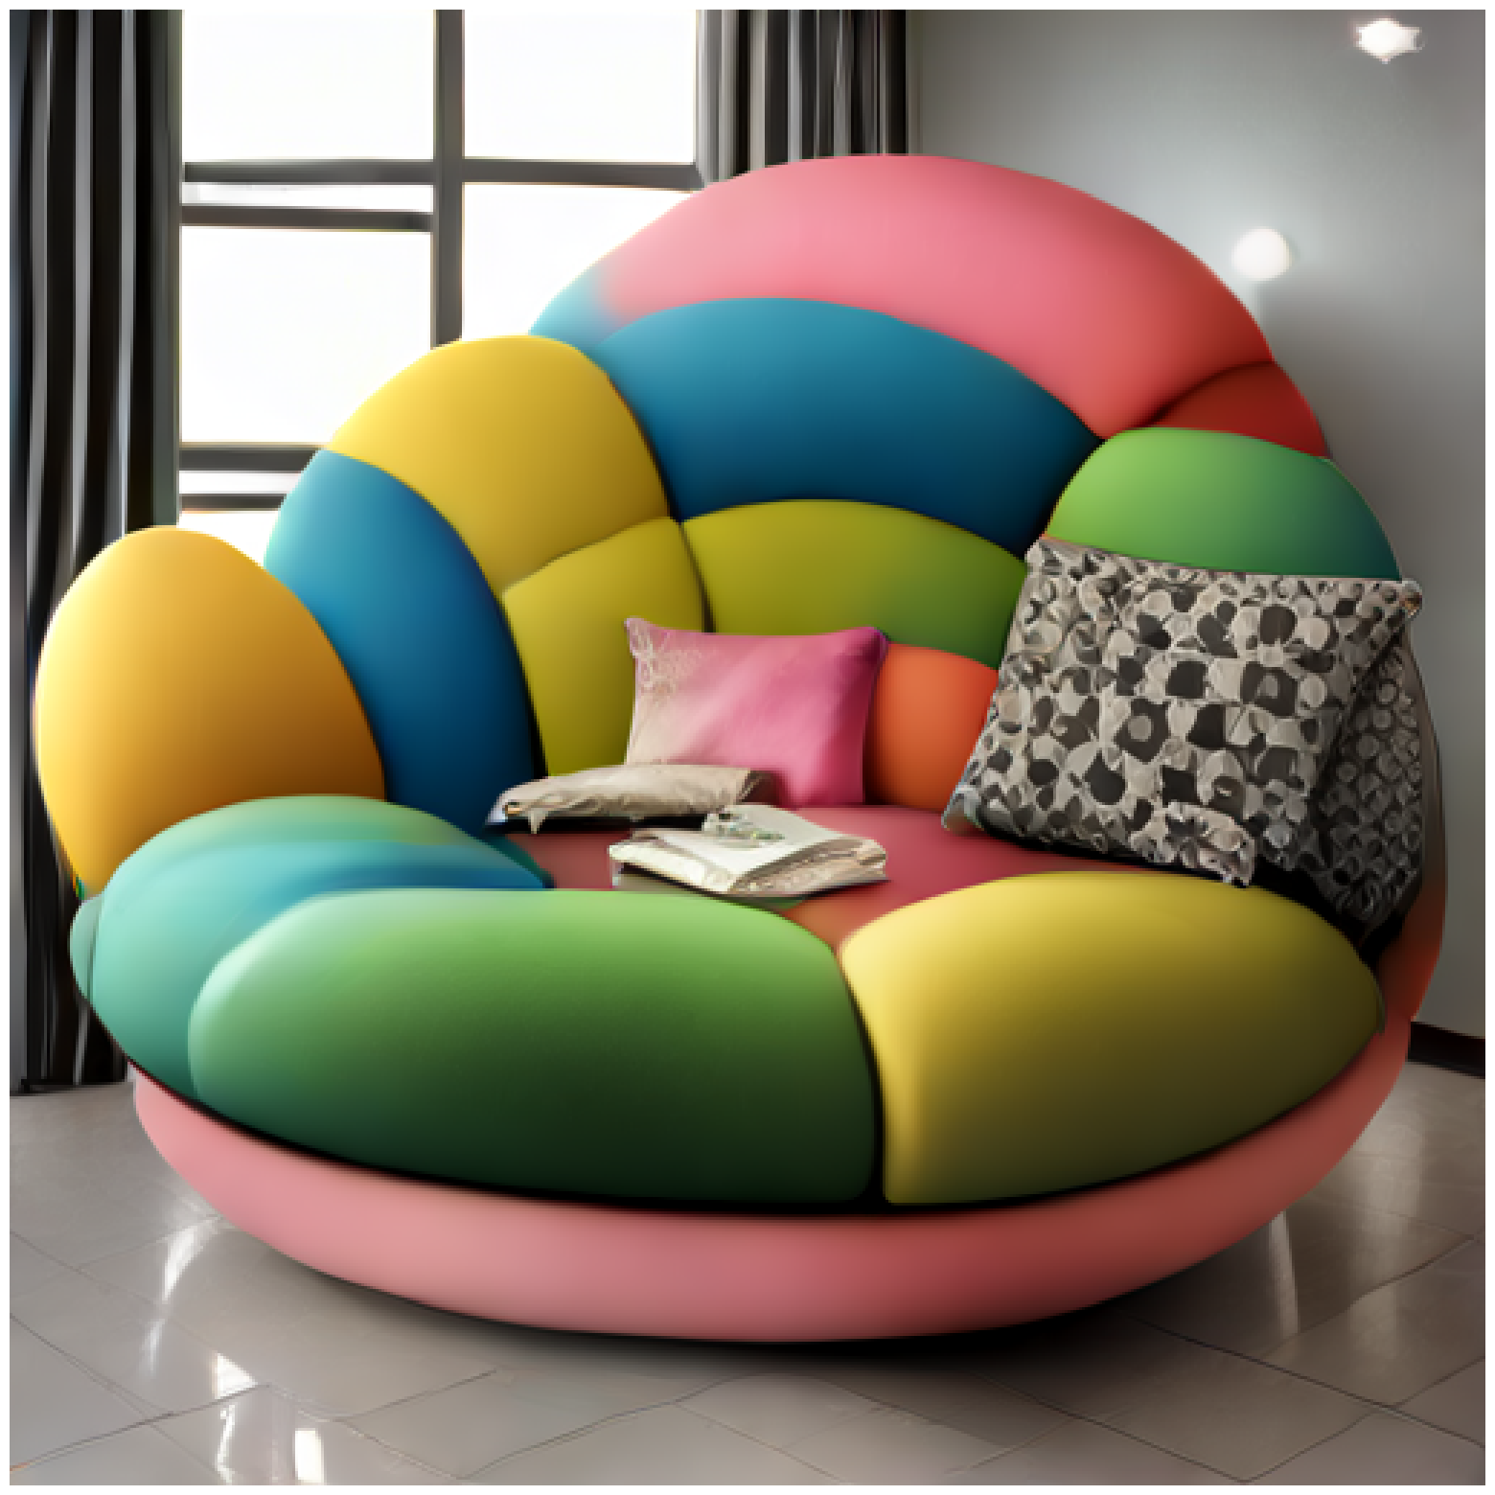
“a creative design of furniture”
“a creative log cabin in the forest”
SDXL
Lightning 1-step
“a creative cup”
“a creative sofa with round shape”
Lightning 4-step
Turbo

Slide 2
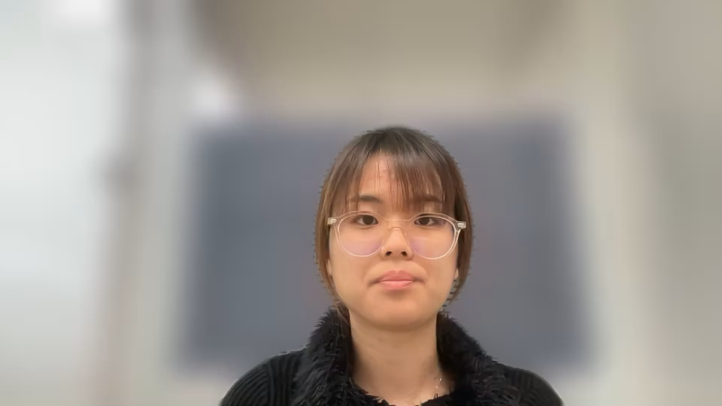
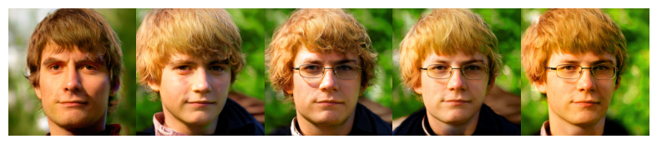
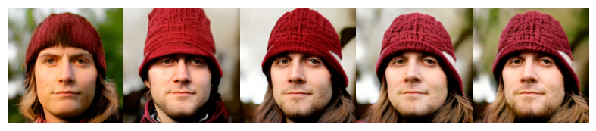
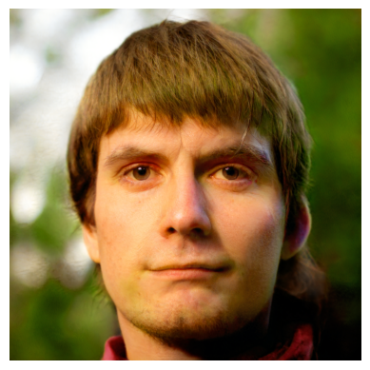
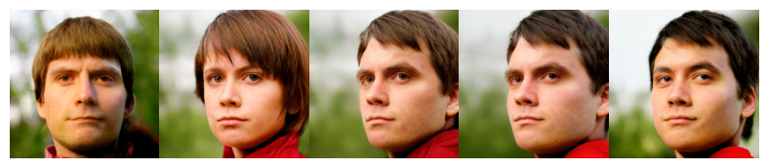
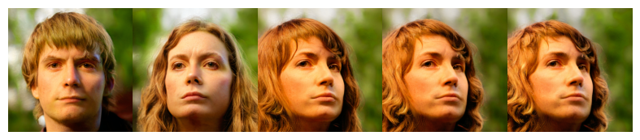
Diverse Rare Sample Generation with Pretrained GANs
Motivation
How to obtain diverse rare samples with fine quality and lower computational costs?
Is it possible to create diverse rare variations of a given reference image?
Getting Rarer
Reference
Getting More Diverse
Notes:
This led us to ask a crucial question: How can we generate diverse rare samples with high quality and lower computational costs? To refine this further, we also ask: Is it possible to create diverse rare variations of a given reference image?
Here, you can see examples generated by our algorithm, which transforms a single reference image into multiple rare variations.

Slide 3
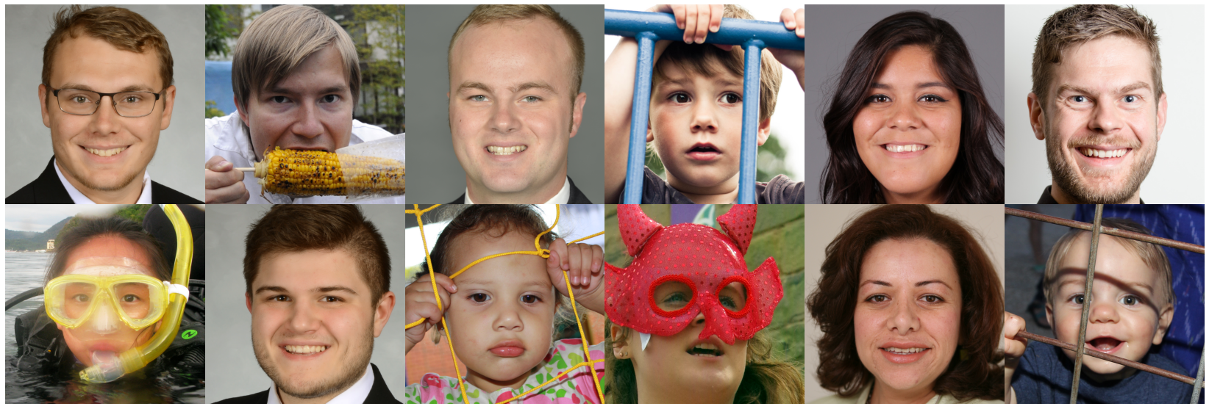
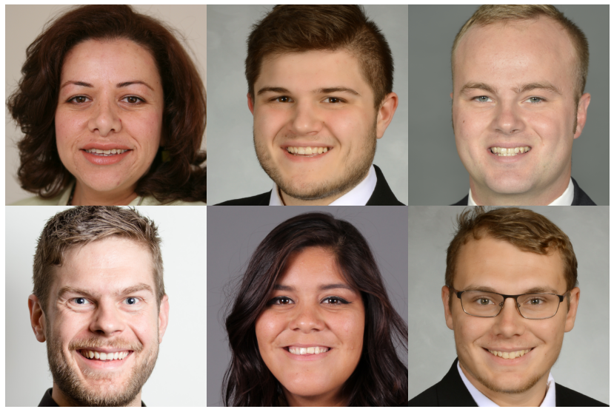
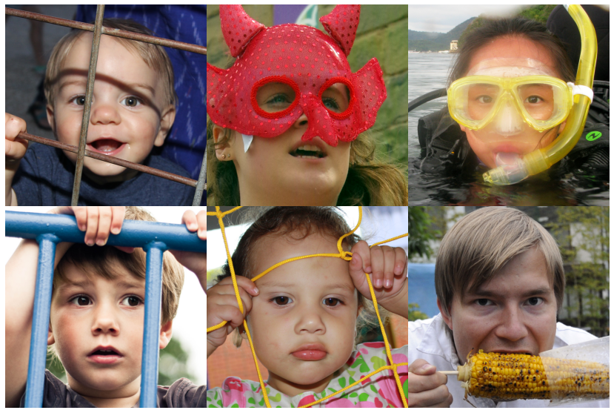
Motivation
Recently the generative models have achieved significant advancements (GAN, diffusion model, etc.).
There are several metrics to assess the overall generation quality of generative models, in terms of fidelity or diversity.
Yet, there is no metric to quantify uniqueness or rarity of an individual generated sample.
What if one may want to select a generated image that has stronger characteristics?
Notes:
Recently, the generative models have achieved significant improvements in generation quality through GANs or diffusion models.
To assess the generation quality the generative models, there have been proposed several metrics such as FID or Precision and recall and so on.
However, most of the metrics focus on the overall generation quality of generative models rather than individual sample.
There are some works that measure the fidelity of an individual sample but there is no metric to quantify the uniqueness or rarity of an individual generation to the best of our knowledge.
Suppose we have a bunch of images,
How do we select generated images that have strong characteristics?

Slide 4
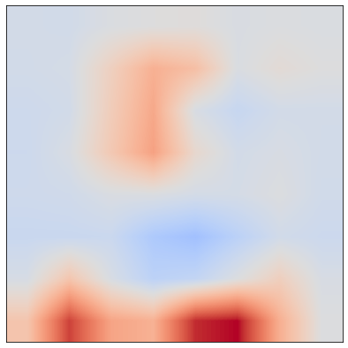
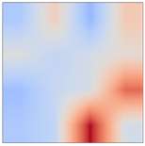
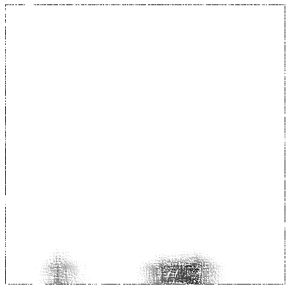
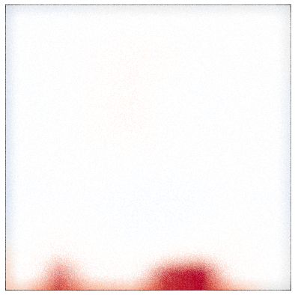
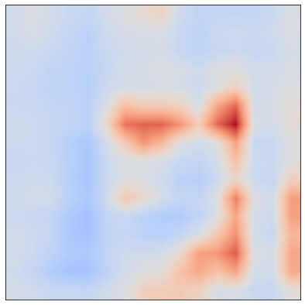
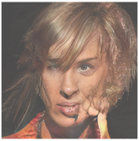
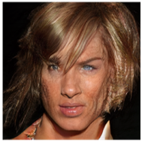
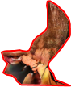
How to correct artifacts without retraining?
We compile a large dataset of curated flawed generated and normal generations.
We identify defective units based on matching score with obtained ground truth.
We propose an artifact removal method by globally ablating defective units which enhances the quality of artifact samples.
Notes:
As training GAN models is both computationally expensive and time consuming a way to correct artifact images without retraining will be a more viable solution.
For this purpose, we compile a large dataset of curated flawed generated and normal generations and provide statistical analysis for the portion of input space causing artifacts.
We identify defective units by measuring the intersection-over-union (IoU) of the unit’s activation map and pseudo artifact region masks obtained by training a simple classifier on our dataset.
We propose an artifact removal method by ablating defective units which enhances the quality of artifact samples while maintaining normal samples from drastic change.

Slide 5
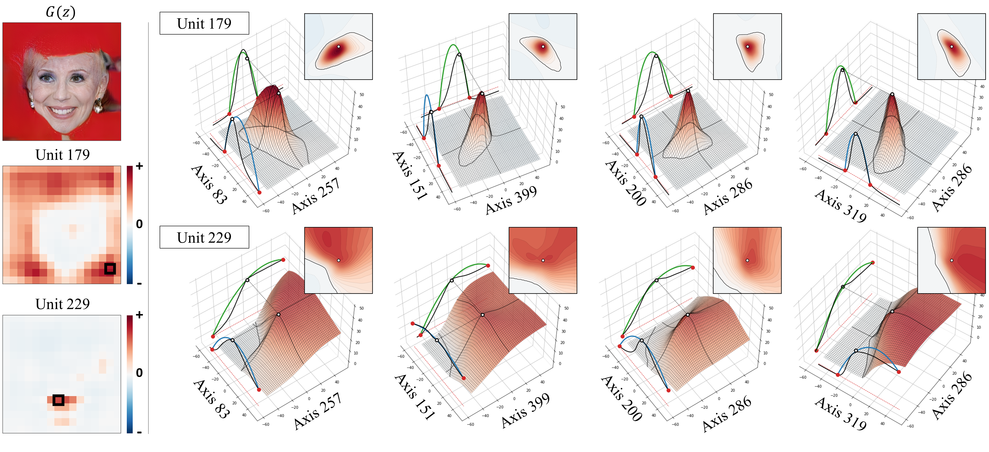
Locally Activated Neurons in GANs
From the previous work,
Each internal featuremap unit in the $G$ handles a specific object (include type of artifacts) for the final generation
We expand observations and focus on neurons (i.e., feature pixel) as the basic component of a unit
Unit 179
Unit 229
Notes:
This is another example with the 3D representation.
The neuron in Unit 179, which corresponds to the artifact area in the generation, shows bounded activation pattern around the given latent code in multiple cross sections in the latent space,
while the neuron in unit 229, which corresponds to the mouth in the face, shows smooth activation change over a large region in the latent space.

